Slide 1
Workshop Penyegaran
Program Inovasi IPB
Kamis, 1 Oktober 2020, via Zoom
Kristanto Santosa
Business Innovation Center
(http://bic.web.id)
From the “Best University” to “Best Entrepreneurial University”

Slide 2
RESEARCH & INNOVATION
A SELF REINFORCING LOOP
Research: Transforming
Money into Knowledge
& Discoveries
Innovation: Transforming Knowledge “Back”
into Value / Money
Notes:
Catatan:
Inovasi tidak saja harus mampu untuk memanfaatkan hasil riset, tapi juga harus cukup berhasil menciptakan nilai tambah yang pada gilirannya harus menjadi sumber pendanaan untuk riset berikutnya. Research & innovation harus dilihat sebagai “self reinforcing” loop (KS/BIC)

Slide 3
BIC Business Model
(as “Intermediary” )
Business Model:
Market
Value Proposition
Value Chain
Cost & Profit
Value Network
Competitive Strategy
Technical Inputs:
e.g.
Feasibility, Performance
Economic Output :
e.g.
Value,
Price,
Profit
Domain Akademik
Domain Ekonomi

Slide 4
BIC Innovation Management System Diagram
INCUBATION
EXPERT REVIEW PROCESS
JURIES ASSIGNMENT
ADMINISTRATIVE PROCESS
Vetoed
SELECTION PROCESS
PROPOSAL CANCELATION
ADMINSTRATIVE REVIEW PROCESS
PROPOSAL ASSIGNMENT
Selected
Not Selected
INNOVATION DATABASE
DISCONTINUED
NEW
REVIEW
TO REVISE
IN-REVIEW
SELECTION
APPROVED
LISTED
Registration & Proposal Submission
Proposal Revised
INNOVATOR PROCESS
Proposal Completed
AWARD &
PUBLICATION
PROMOTION
PROCESS
Incubation, Intermediation Promotion
Transfer to Innovators’ Innovation “Showroom@BIC”: e-Incubator

Slide 5
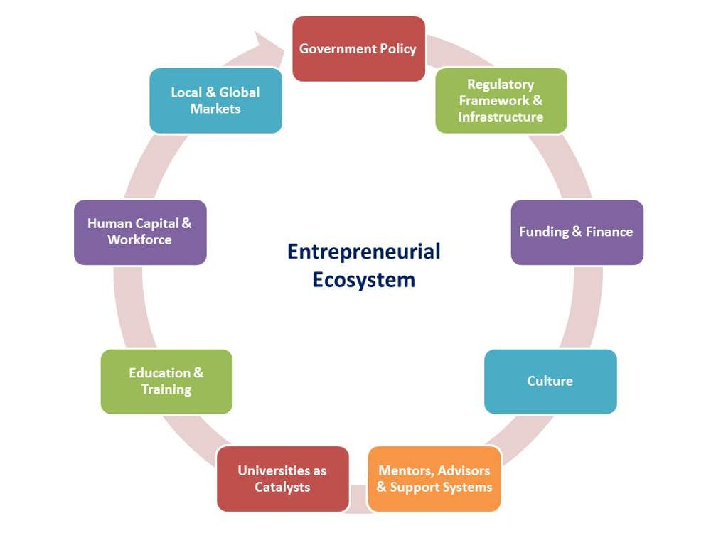
Entrepreneurial Ecosystems
https://theconversation.com/entrepreneurial-ecosystems-and-the-role-of-government-policy-35809

Slide 6
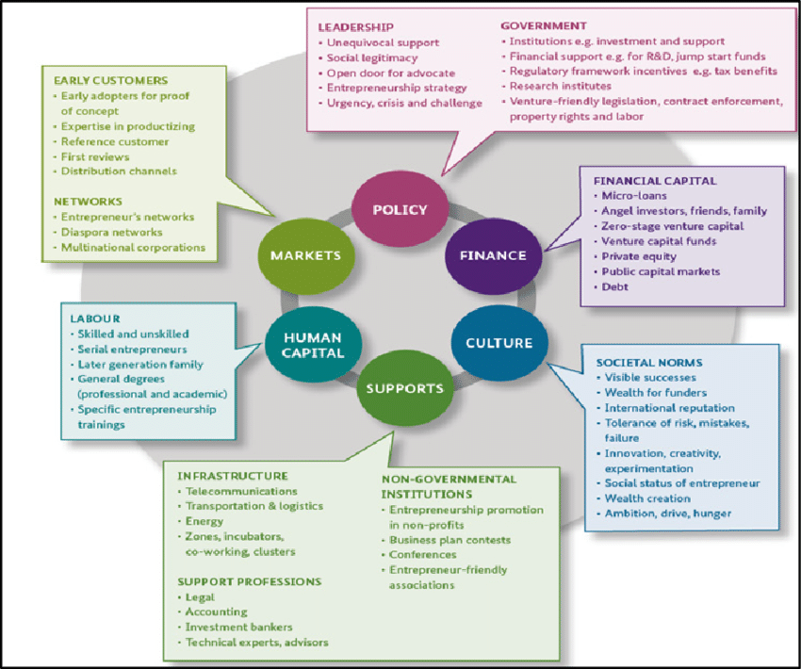
Entrepreneurial Ecosystem (Ekosistem Kewirausahaan)
MARKET / DEMAND !
EARLY CUSTOMERS
Early adopters for proof of concept
Expertise in productizing
Reference Customers
First reviews
Distribution channels
NETWORKS
Entrepreneur’s networks
Diaspora networks
Multinational corporations
https://www.researchgate.net/figure/Isenbergs-model-of-an-entrepreneurship-ecosystem-Source-Regh-Fuer-GmbH-2018_fig3_329015267
Notes:
The term “ecosystem” was coined by James Moore in 1993 in his research in the Harvard Business Review. He argues that companies are part of a business ecosystem that crosses industrial
boundaries. , Many theories and models have been developed since Moore’s article in 1993 (the latest model being by Spiegel (2017)) in order to gain more insight into how entrepreneurial
ecosystem is designed. Moore illustrates how an entrepreneurial ecosystem would “cooperatively and competitively to support new products, satisfy customer needs, and eventually incorporate the
next round of innovation” (Moore, 1993). Furthermore, research by Stam & Spiegel (2016) showed how a rich ecosystem “enables entrepreneurship and subsequent value creation at the regional
level” (Stam, 2016). Therefore, this idea has become more widespread and popular in the literature, which has encouraged governments to focus on building entrepreneurial ecosystems (Mason and
Brown, 2014). However, the latest definition of an entrepreneurial ecosystem, presented by Spiegel in (2017), is as follows: An entrepreneurial ecosystem is interdependent group of local
culture (actors), social networks, universities, sources of investment, economic policies (factors) coordinated in such a way as to create a good environment that enable productive
entrepreneurship in a particular region (Spiegel, 2017).
In recent years, many models have been created to gain better understanding of how to develop ecosystems for entrepreneurship but this current study has limited discussion to two of the
most famous models; the Isenberg (2011), and Stam (2015) frameworks. The Isenberg framework (2011), suggests that the entrepreneurship ecosystem must include
six key dimensions with twelve elements incorporated together. These are: policy (leadership, government); finance (financial capital); culture (success stories, societal norms); supports
(infrastructure, support professions); human capital (labour, educational institutions); and markets (early customers, networks) (Isenberg, 2011). However, these domains largely overlap with the
eight World Economic Forum pillars (WEF 2013) of successful entrepreneurship ecosystems. These are; human capital, cultural support, education & training, markets, major universities,
government, funding, and regulatory framework (Sala et al., 2013). As in other examples of popular literature, the Isenberg approach puts entrepreneurship at the center of the framework, recognizing
the importance that entrepreneurship plays as a key element and recognizing the main factors that are essential for the success of the entrepreneurial ecosystem. These are: actors, customers,
resources, and institutions (Jansen, 2017). Meanwhile, the WEF also presented the main elements within each pillar: the actors involved; human capital; access to customers; finance & services; and
institutions (Spigel, 2017; Stam, 2016).
Also see: https://www.oecd.org/cfe/leed/Entrepreneurial-ecosystems.pdf

Slide 7
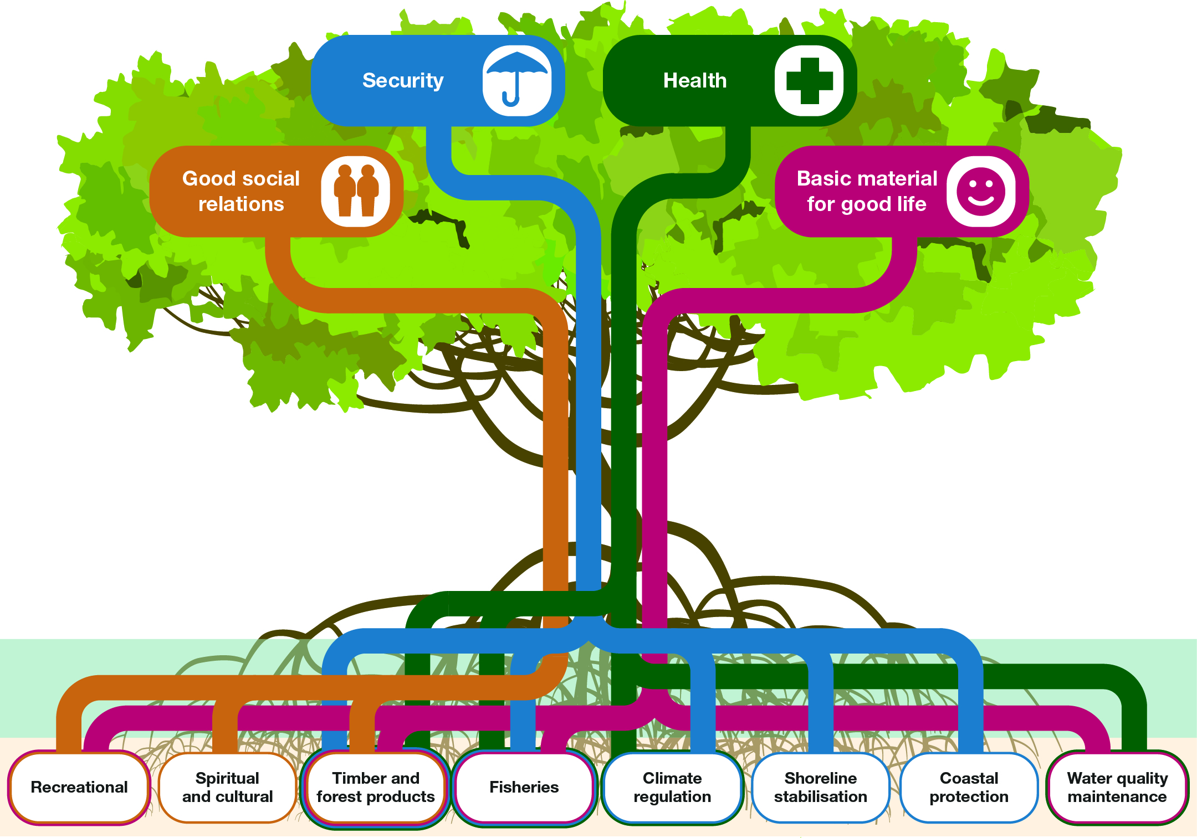
Towards “ A Mangrove Forest” Innovation Ecosystems
© - Florin Paun, 2018
Ce document et l’information contenue sont la propriété de Florin Paun. Toute reproduction est interdite sans l’accord de l’auteur.

